Slide 1
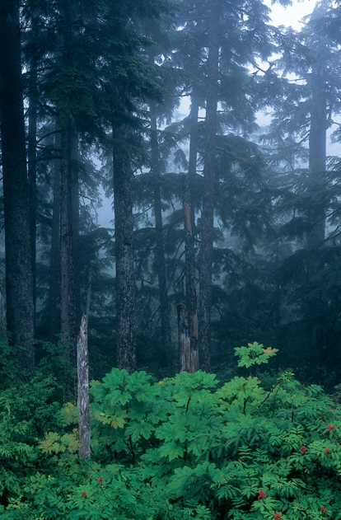
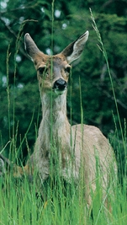
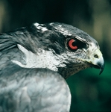
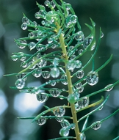

The Alaskan Rainforest
Alaska Department of Fish and Game
Notes:
Note to Teachers: This slideshow is intended to be an overview of the temperate rainforest in Southeast Alaska. You will want to take time ahead of presenting this to your students to review the slides and use the notes as a guideline to create your own presentation. The notes are not intended to be read as a script. There is very little text with the images, so you may include as much information as you like, depending upon your students interest and attention.

Slide 2
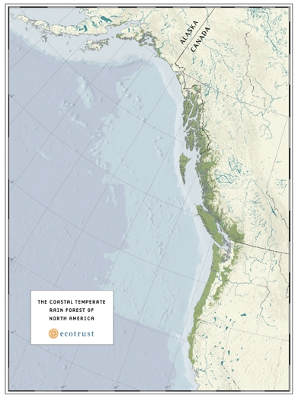
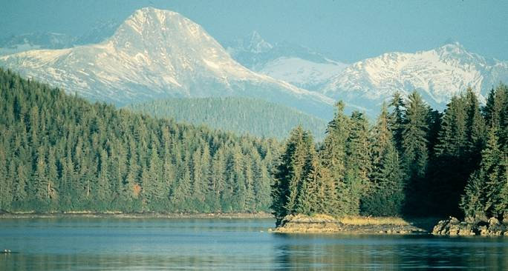
The Alaskan rainforest: natural history
The Coastal Temperate
Rainforest of North America
Map reprinted by permission of Ecotrust
©John Schoen
Notes:
Where do we find temperate rainforests in the world? They extend from northern California, along coastal British Columbia and to the eastern edge of Kodiak archipelago in southcentral Alaska. Southeast Alaska lies at the heart of the North American temperate rainforest. Smaller temperate rainforest are found in southern Chile, Scandinavia, New Zealand and Tasmania.
Much of Alaska’s rainforest is on National Forest land. National Forests are public lands managed by the Forest Service. About 77% of Southeast Alaska, the nation’s largest is Tongass National Forest. The nation’s second largest national forest, the Chugach, extends north from Cordova to Kodiak.
What makes temperate rainforest different from tropical rainforests? (Cooler, but just as wet, averaging 200 inches/year.)
The climate is moderated by its proximity to the ocean. The ocean current brings warmer water from Japan in the winter, keeping the water temperature well above freezing. (approx. 42 F) In the summer, the ocean’s temperature (55 F) creates fog, which keeps it cooler. “It’s not too hot, nor is it too cold.”
What do you notice in this picture? It is striking to see the ocean, forest and large glacial peaks in such close proximity to one another. In Southeast Alaska, you may travel a distance of only 8 miles and go from sea-level to ice-fields at elevations of over 5,000 ft. The closeness of the mountains to the sea contributes to the huge amount of precipitation along the coast. The mountains act as a barrier to the clouds, which release accumulated moisture to the coastal forests below.

Slide 3
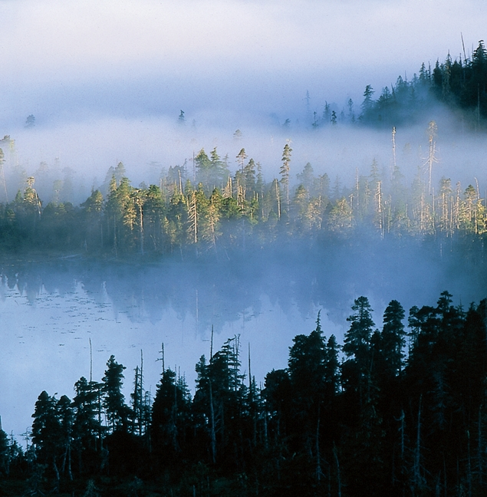
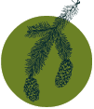

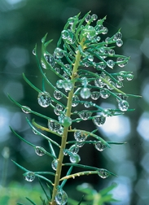

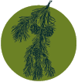
The Alaskan rainforest: trees
Sitka
spruce
western
hemlock
western
red cedar
Sitka spruce tip
©Norio Matsumoto
shore
(lodgepole)
pine
Craig Flatten, ADF&G
Notes:
These forests cover the islands and mainland along the southern coast of Alaska. Generally, they are found below 2,500 feet and the trees grow largest in broad river valleys with well-drained soil. This slide represents the most common tree species. Are there a lot of different kinds of trees? (No, temperate forests don’t have the diversity of tropical rainforests, but they have the greatest amount of living plant life per area of any forest in the world. However, temperate forests have the highest diversity of coniferous trees. In northwestern California, you can find 17 species of coniferous trees w/in 1 square mile, it’s called the “Miracle Mile”.)
How tall do you think some of these trees grow? (Over 200 feet)
How big are these trees? (Up to 12 feet in diameter) How many students would it take to get around a tree this size? (approximately 8 students joined together with hands outstretched.)

Slide 4
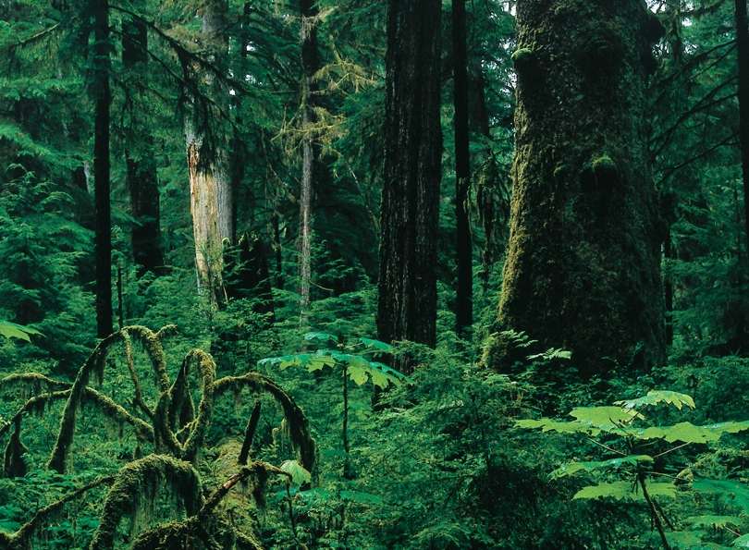
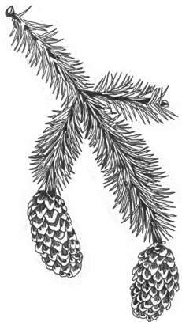
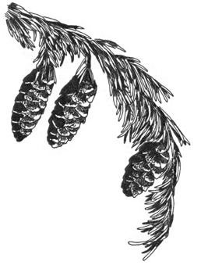
Sitka Spruce
Western Hemlock
What are the differences between
the Sitka Spruce and Western Hemlock?
Notes:
Sitka Spruce has needles growing all the way around the stem and they are prickly to touch. The cones are larger and when pulled apart the seeds are winged. The Western Hemlock’s needles lay flat and its cones are much smaller. This drawing doesn’t show the size difference. (Passing out examples of each tree type at this point would be helpful.)
An important difference between these two trees is the way they grow. Spruce do not grow well in thick shade, so they are the first conifers to take-off when light is available. The hemlock grow well in low light and eventually reach heights taller than the spruce. That is one reason old-growth forests have more hemlock than spruce trees.

Slide 5
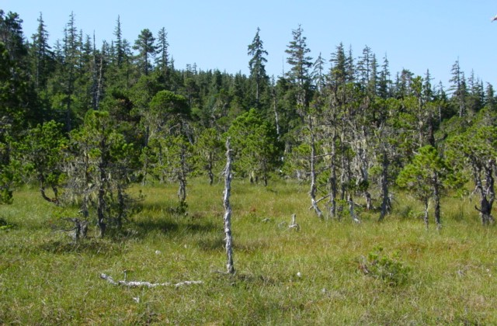
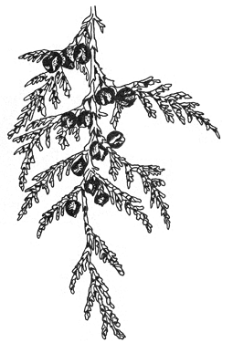
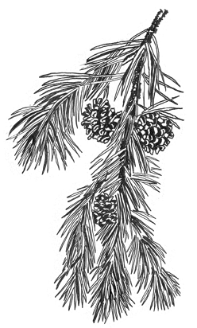
Western Red Cedar
Shore (lodgepole) Pine
Notes:
Western Red Cedar and Shore Pine are not as common as spruce and hemlock and are less widely distributed. Western Red Cedar is prominent in the southern islands such as Prince of Wales Island, but rare anywhere north of Petersburg.
Shore Pine and Yellow Cedar are found in wet, poorly drained areas. Can you think of a natural community here in Southeast Alaska where you see these kinds of trees? (Muskeg or Bog) They are also known as peatlands, due to the thick layers of peat present. Peat is made up of slowly decomposing dead moss and sedges that accumulates over thousands of years.

Slide 6
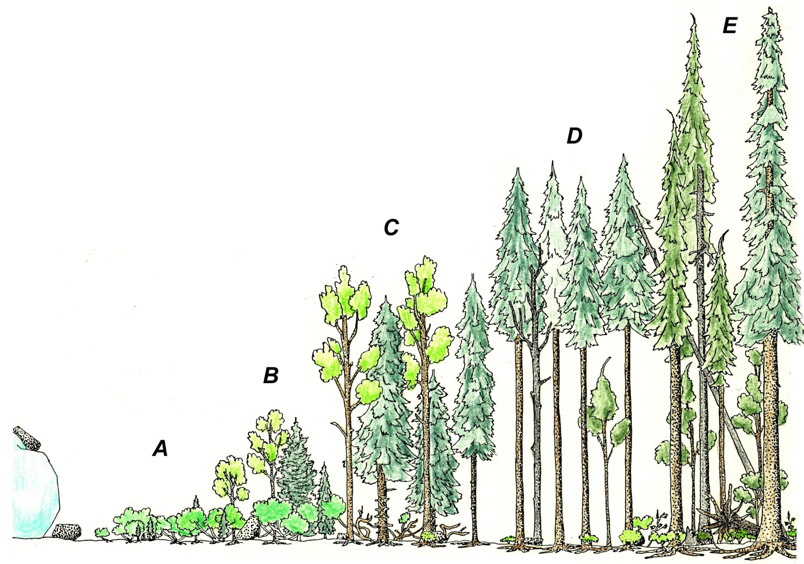
Primary Succession
©Richard Carstensen
0 years
Glacier snout
25 years
Alder-willow
50 years
Thickets overtopped
100 years
Mixed spruce
And cottonwood
200 years
Even-aged spruce
400+ years
Multi-aged
Hemlock-spruce
Notes:
Southeast Alaska is a perfect outdoor classroom for studying forest succession. Succession refers to the replacement of one natural community by another. The illustration shows the stages from bare rock to the development of an old-growth forest. The sequence here is typical of moderately well-drained glacial till—an unsorted mix of all particle sizes from boulders down to clay. The pattern and rate of succession will differ on other substrates.
Following the retreat of the glaciers, the land itself rises, as the heavy weight of the ice is lifted. We call this glacial rebound. Along coastal Alaska, evidence of this uplift is seen in the marine terraces rising back into the adjacent forest. Uplifted shorelines caused by glacial retreat are examples of places where primary succession occurs. Other examples of natural events that may create bare soil or rock where primary succession can begin include: volcanic events, earthquakes, fires, floods and landslides.
What successional stages do you think provide the greatest diversity of wildlife?
In the pioneer stage, plants begin to make the soil allowing other plants to follow with wildlife close behind. The grasses and forbs produce food for herbivores such as insects, deer, mice and birds. Carnivores, such as wolves and ermine move in to feed on these herbivores. When alder, willow and cottonwood move in and shade the sun-loving pioneer plants, larger herbivores such as moose come to feed as the shrubs grow taller. Bears and wolves quickly follow. More insects can survive and with them their predators (shrews, swallows and warblers). In the even-aged forest, Sitka Spruce dominate and shade out the deciduous plants, providing meager food for wildlife. As the spruce die, shade-tolerant hemlock saplings become giant trees and the forest changes to an old-growth, climax forest. 600 years after succession began on bare ground, the forest becomes self-renewing and is the most diversified habitat in the Alaska rainforest.

Slide 7
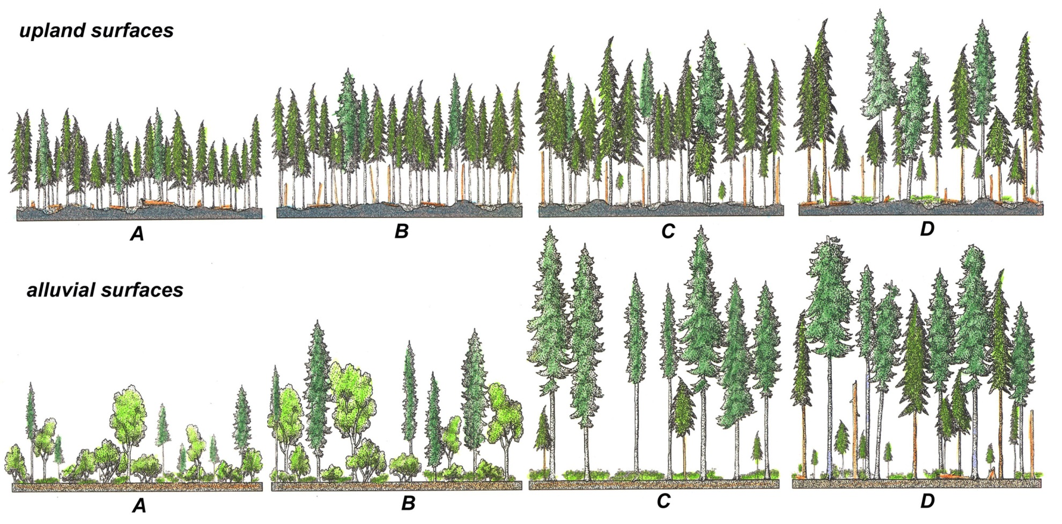
Secondary Succession
©Richard Carstensen
Notes:
Secondary Succession is the change in plant and animal communities that follows a disturbance of an existing environment, where organic soil remains following the event. Secondary succession usually occurs as a result of small-scale disturbances such as insect and disease outbreaks, avalanches, wind storms, and human activities such as logging.
The upper series traces forest development after a severe windstorm on the upper slopes where large stands of tree topple. This is called a stand-replacing blowdown. The lower series follows succession after major flooding in lowland valley eliminating most of the big trees from previous stream or riverside forests. This is a great illustration to simply ask the students what differences they observe. In comparing the two sequences, it becomes evident that succession occurs differently depending on the site itself and the origin of the disturbance. If you’d like to provide details regarding these drawings, please refer to background information for additional information regarding forest succession and details about this particular slide. (Limited space prohibited adding the information here. Please open the word file found on the CD for further discussion on secondary succession.)

Slide 8
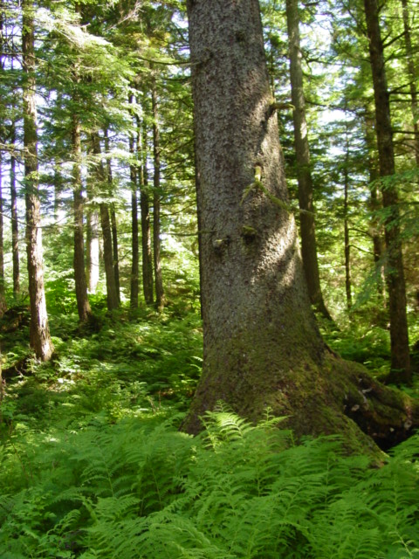
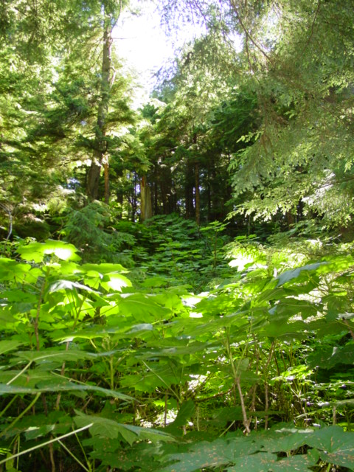
Multi-Aged Forest
Kristen Romanoff, ADF&G
Kristen Romanoff, ADF&G
Notes:
Multi-aged trees are an important characteristic of the old-growth forest. Can you think of any reasons why trees of different ages and sizes would be important to wildlife, for example?
For one, the different sizes of the trees allow light to penetrate the canopy. (Canopy refers to the upper layer of a forest where treetops meet.) If all of the trees were the same size, the canopy would form an umbrella cover, making it difficult for light to get into the understory. (Understory refers to the layer of plants growing between the forest canopy and the ground cover.) The light filtering into the forest allows a diversity of plants to grow, which provides food for herbivores (plant-eaters), such as deer.
Another important factor for wildlife has to do with the upper canopy in the winter time. Why?
The tallest trees intercept falling snow, leaving the forest floor relatively free of snow, giving deer easy access to food and shelter from winter storms. Biologists have found that brown bears, river otters, and even mountain goats use old-growth forests during the winter.

Slide 9
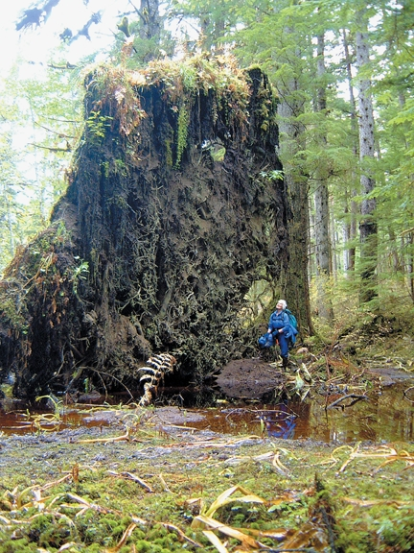
Fallen Trees and Canopy Gaps
Kristen Romanoff, ADF&G
©Bob Armstrong
Notes:
Because of shallow soils and high water tables, the roots of 200-foot tall trees often extend no deeper than 24 inches into the soil. Trees often fall over in the rainy fall season, when soils are saturated, and winds more than 50 miles per hour sweep onshore from the Gulf of Alaska. These fallen trees, and the canopy openings (gaps) they create, are essential elements of the rainforest. The gaps allow light to penetrate to the forest floor and generate new growth. Red alder, salmonberry and devil’s club are a few plants who thrive in newly-created openings in the otherwise thick canopy of the forest.

Slide 10
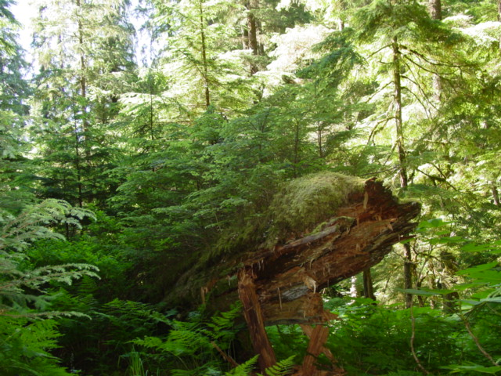
Nurse Logs
Kristen Romanoff, ADF&G
Notes:
Fallen trees are scattered throughout the rainforest. These “dead” trees support all kinds of living creatures including: insects, small mammals and birds. Seedlings start to grow on decaying fallen tree trunks, because the decaying wood is excellent substrate for seeds to germinate and grow, decaying wood provides nutrients to the young trees and fallen logs hold seedlings above other plant competition on the ground. These fallen trees act as nurseries for seedlings and are called “nurse logs”. Long after the fallen tree has decayed, there is evidence of this “nurse log”; young trees growing in rows, as if they were planted by hand.
Can you think of other ways fallen trees are beneficial to plants and animals of the rainforest? What happens when a tree falls into a stream? (The fallen tree slows the current, creating pools for fish and insects. This is important habitat. The fallen log also stabilizes the stream bank, minimizing erosion.)

Slide 11
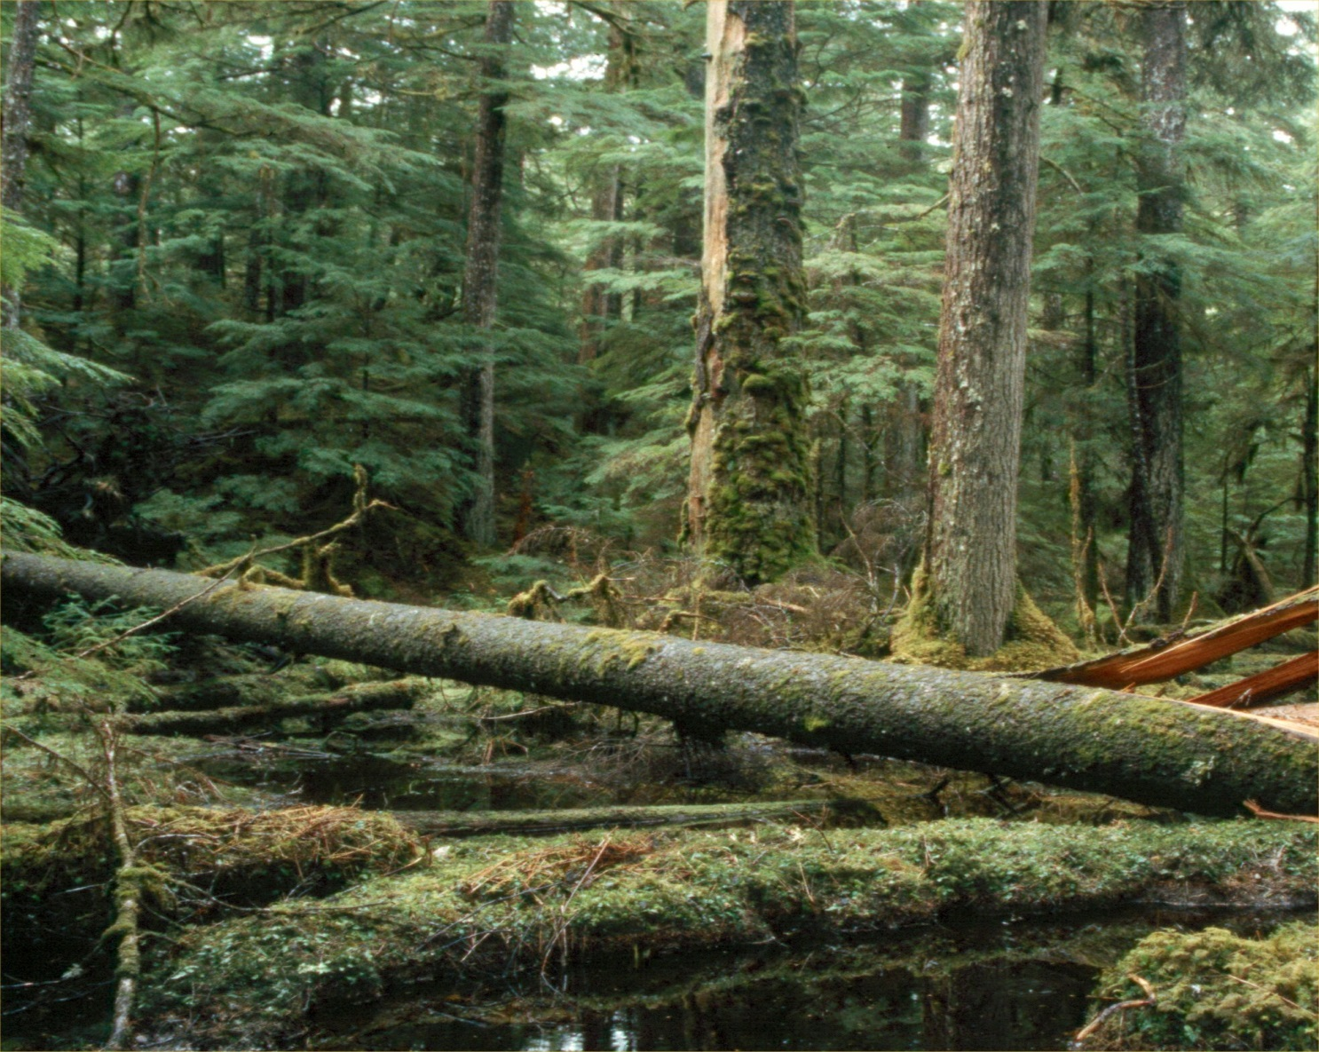
The Carbon Connection
Jeff Nicols, ADF&G
Notes:
Winter storms are fast and furious, toppling large swaths of trees, leaving a thick layer of wood and needles to decompose on the forest floor. The atmospheric carbon that has accumulated in the trees and is not consumed by other organisms, is buried in the forest. Otherwise, the carbon would continue to accumulate in the atmosphere. Accumulations of carbon dioxide in the atmosphere are increasing dramatically. Many scientists believe this is leading to global climate change. (The Greenhouse Effect) Temperate rainforests help slow down the release of carbon. This is just one of many important roles the rainforest plays in our lives.

Slide 12
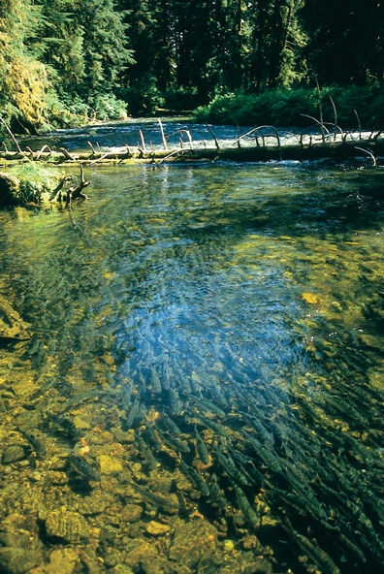
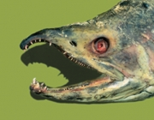

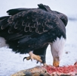

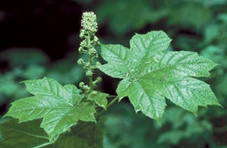
The Alaskan rainforest: an ecological web
Jon Lyman, ADF&G
pink salmon
John Hyde, ADF&G
brown bear
How do fish feed the rainforest?
John Hyde, ADF&G
Norio Matsumoto
Bald eagle
©Bob Armstrong
devil’s club
Jeff Nichols
angler
Notes:
The Alaskan rainforest is home to a complex web of ecological inter-relationships that scientists are just beginning to understand. What do you think about this question? How do fish feed the rainforest?
There are rich populations of invertebrates, such as stoneflies and mayflies, in freshwater streams where salmon spawn. It turns out that Pacific salmon, which return to their birth streams to reproduce and die, carry lots of nutrients accumulated in their bodies during years of life in the ocean. After they die, these nutrients are released into the streams, fertilizing and enriching the stream and all the other animals living in the stream. Even the trees and shrubs growing near the stream benefit. Bears, eagles, marten, wolves and other piscivores (fish eaters) haul thousands of carcasses each year onto the stream banks, where they are partially consumed and left to fertilize the forest.

Slide 13
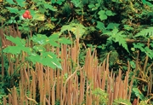

The Alaskan Rainforest: an ecological web
From Top to Bottom
“Scuzz” to Mycorrhizal Fungi
How are these important
to the rainforest?
“Worm fungus” Jeff Nichols
©Bob Armstrong
Microscopic views of mycorrhizal fungi. Dr. Robin Rose
Notes:
Less obvious, but no less important, are the inter-relationships that exist on a microscopic level. With the aid of a microscope, one can look closely at the individual needles of old trees and see a complex community of single-cell algae, yeasts and bacteria coating the surface. Scientists call this “scuzz” and it is food for lots of tiny grazing invertebrates, such as mites and springtails. Moving one step up the food chain, larger invertebrates, such as spiders, prey upon the mites and springtails. Here, finally, is a species that the average hiker in the forest will notice. Scientists think this microscopic community of grazers and predators explains the temperate rainforest’s incredible resistance to attack by insect pests. Predacious insects and spiders help to thwart attacks by leaf-eating insects that would otherwise cause severe damage to the trees.
Just as “scuzz” grows on needles at the top of a towering 200-foot tree, an entirely different microscopic community is at work on the other end of the tree—its roots. Roots branch into finer rootlets that eventually end in millions of tiny “hairs” barely visible to the human eye. This is where nutrients and water transfer from soil to tree. In a healthy forest, the soil is filled with microscopic organisms, including a special type of mycorrhizal fungi (fungus-root) that coat the surface of the tiniest root hairs. These fungi help in the absorption of nutrients (minerals, nitrogen and carbon) and water by the tree, and in return receive nourishment (carbohydrates) from the tree. Without these fungi, tree growth is limited. The fungi are unable to live independenly.
So from the tips of needles to the tips of root hairs and on every surface between, complex ecological relationships are playing themselves out in the Alaska rainforest. It is this interweaving (ecological web) that contributes to the stability and vitality of this unique ecosystem. Untold secrets of the Alaskan rainforest will undoubtedly be discovered by future generations of scientists. Perhaps even some of you! We’ve only begun to scratch the surface.
Can you think of any other inter-relationships in the rainforest? think about food chains…

Slide 14
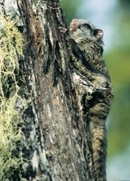
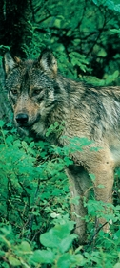
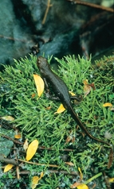
The Alaskan rainforest: wildlife
Jeff Nichols
Northern Flying Squirrel
Gail Blundell
Alexander Archipelago wolf
Gail Blundell
Jeff Nichols
Sitka black-tailed deer
Rough-skinned newt
Notes:
The rainforest environment of Alaska is home to at least 40 species of land mammals, more than 200 species of birds, 5 amphibians and a single reptile species (the garter snake). The ways in which these species make a living in the rainforest are as fascinating as they are varied.

Slide 15
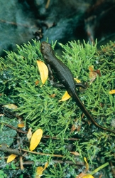
The Alaskan rainforest: every species has a story to tell…
Northern Flying Squirrel
Rough-skinned newt
Notes:
The northern flying squirrel is a small nocturnal mammal known for its ability to glide on specialized flaps of skin up to 100 yards (the length of a soccer field) through the forest canopy. This secretive creature eats lichens found in the forest canopy (treetops) and truffles, an aromatic underground fungi. Different than the seed-eating diets of most squirrels, this diet is perfectly matched to the moist environment of the Alaskan rainforest with its diversity and abundance of lichens and fungi.
The rough-skinned newt is one of the most poisonous salamanders on earth, with glands under its skin that contain a toxin ten times more potent than cyanide. Predators steer clear of this salamander. Despite looking like a dragon as it creeps through the old-growth understory and emerges from its favored haunts beneath rotten logs or small seeps, the four-inch-long newt is really a non-threatening creature of the rainforest. (as long as you don’t eat them!)

Slide 16
The Alaskan rainforest: every species has a story to tell…
Alexander Archipelago wolf
Sitka black-tailed deer
Notes:
Larger mammals, such as wolves and deer, have been more intensively studied than the smaller animals living in the Alaskan rainforest. Beginning in the 1970’s, state biologists initiated studies on the role old-growth forest plays in providing habitat for Sitka black-tailed deer. Among other things, biologists learned that the multi-layered canopy of the old-growth forest intercepts (catches) most of the winter’s snow, making plants on the ground below available to deer. And the larger the trees, the more snow they intercepted. Biologists also discovered that plants which are grown in the shade of the forest are more nutritious and digestible than the same plant species grown in open clear-cuts.
Healthy deep populations are important for many reason including food for the Alexander Archipelago wolf. A smaller, darker-colored variant of its northern cousins, the Alexander Archipelago wolf is a subspecies linked to the rainforest environment. These wolves range over 100-square-mile territories in search of deer, their primary prey. However, they supplement this diet with some unexpected prey, including waterfowl, seals, salmon and even black bears! One study found wolves feeding heavily on salmon, foraging similarly to the celebrated bears of coastal Alaska.

Slide 17
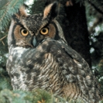
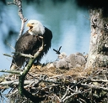
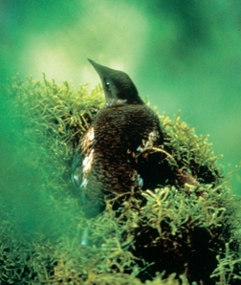
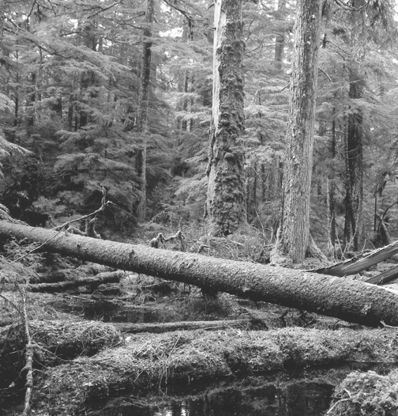
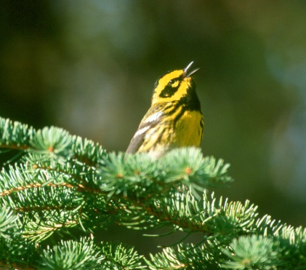
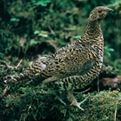
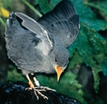
John Schoen
Bob Armstrong
Jeff Hughes, ADF&G
Bald Eagle
Great Horned Owl
Birds
Marbled Murrelet
Craig Flatten, ADG&G
Ted Swem
Northern Goshawk
Townsend’s Warbler
Craig Flatten, ADF&G
Jamie Womble
Spruce Grouse
American Dipper
Notes:
A diverse array of birds inhabit the rainforest. While many rainforest species are migratory (e.g. warblers, hummingbirds and thrushes), others such as ravens, chickadees and winter wrens remain in the rainforest throughout the year. Unlike most songbirds, winter wrens defend their territories year-round, giving us songs in all seasons.

Slide 18

The Alaskan rainforest: birds
Craig Flatten, ADF&G
Jeff Hughes, ADF&G
Ted Swem
Notes:
Some species such as the northern goshawk prefer undisturbed rainforest for foraging and successful breeding. Much research has been done on goshawks in Southeast Alaska, as habitat loss, primarily as a result of logging, poses a threat. The population was under consideration to be listed as a threatened species under the Nation’s Endangered Species Act. However a recent decision was made not to list the goshawk. Even so, there is enough of a threat to these birds that it is currently listed as a “Species of Special Concern”, on Alaska’s list. State species of concern are given special consideration in the planning and permitting projects affecting the species’ habitat on state lands.
The Marbled Murrelet is a seabird that spends most of its life on the ocean. Unlike most seabirds, the marbled murrelet nests on moss-covered limbs high in old-growth . These nests are extremely difficult to find, only six have been documented in Southeast and an additional 27 nests documented in Alaska. Marbled Murrelets are dependent upon old-growth forests for nesting. These birds are federally listed as a threatened species, under the Endangered Species Act. The loss of habitat due to logging in the Pacific Northwest contributed to its decline. Here in Alaska, the Marbled Murrelet population is approximately 800,000 according to a 1998 Breeding Bird Survey, which used survey data from as far back as 1993/94. However, research conducted by USFWS indicate significant declines in Prince William Sound (approx. 65%) and in Glacier Bay (74%) since 1990. It is not known what has caused these declines, but scientists speculate it is primarily related to factors associated with ocean conditions. Trends in Marbled Murrelet population for Southeast Alaska are not known at this time.
Songbirds, such as the Townsend’s Warbler, migrate to Alaska to breed and raise their young. They depend on healthy habitats in Alaska as well as in their wintering grounds in the lower 48 states, Mexico and Central America. Over the past decade, songbird populations have been declining. Scientists attribute this decline to several factors, including loss of habitat, disease, and predation by both natural predators and increasingly by domestic cats.

Slide 19
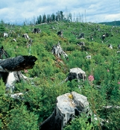
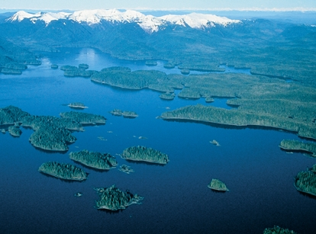
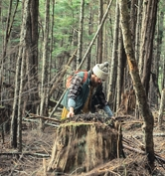
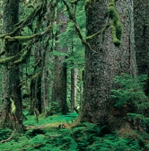
After Logging
5-10 years
Craig Flatten, ADF&G
50-75 years
The Alaskan rainforest: conservation and use
Over 200 years
Notes:
The Alaskan rainforest is large – and largely undeveloped. In Southeast Alaska there are hundreds of islands, 15,000 miles of coastline, over 19 million land acres, and over 5 million acres of pristine old-growth rainforest. Most important– over 90% of the land in Southeast Alaska is public land—managed for you. Proposed uses of public lands invite strong public participation and debate over the future of these lands. Some desire a greater emphasis on logging, mining or tourism developments; others want more wilderness or habitat protection for fish and wildlife. The Forest Service, the primary public land manager in Southeast, makes these land management decisions based on the best available science and national direction. Biologists with the Alaska Department of Fish and Game and other cooperating federal agencies participate in the process by providing valuable research information and expertise. Decisions don’t always end there, sometimes US Congress becomes involved in policy decisions.
One of the most critical and long-lasting debates has been over the use of clear-cut logging techniques. Research studies by multiple agencies have focused on this issue. Several findings have emerged. Clear-cut logging creates two distinct stages of forest succession, both of which differ from the old-growth forests they replace. Young clear-cuts, less than 30 years old, are relatively open and produce abundant understory growth. The value of these early clear-cuts to wildlife depends on the species and the season. As we saw in the succession illustration, after 30-35 years, the young trees overtop shrubs and shade out most of the understory plants. These older second-growth stands provide poor habitat for most wildlife species, and are very long-lasting. It takes over 200 years for these stands to reacquire the uneven-aged tree structure and understory of old growth. Because the effects of this habitat change are not realized until decades after logging, and then last long into the future, the full effect on forest wildlife can be difficult to anticipate.

Slide 20
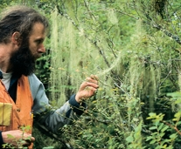
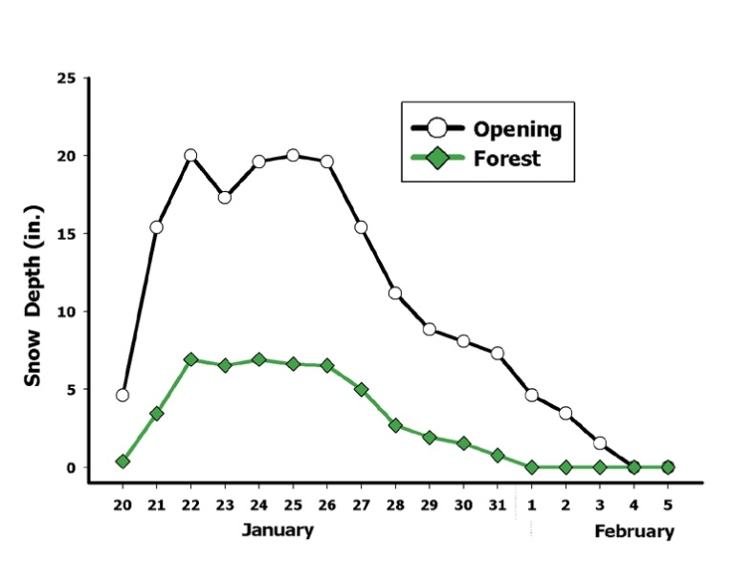
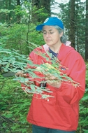
The Alaskan rainforest: research
Matt Kirchhoff, ADF&G
Lichens are sensitive to air pollution, and so, are
a useful indicator of a clean environment.
Data collected by ADF&G biologists studying deer
populations compress snow depths in forest and open areas.
Matt Kirchhoff, ADF&G
A biologist examines a blueberry plant for
evidence of browsing by deer.
Notes:
Biologists at the Alaska Department of Fish and Game and partner federal agencies, have been doing research to better understand the forest’s complex inter-relationships. They have studied ways to conduct logging in the Alaskan rainforest so that wildlife values are not unduly compromised. Department of Fish and Game biologists worked with the Forest Service to design a system of old-growth reserves across the Tongass National Forest to ensure the future of key wildlife species. Their research has helped managers minimize impacts on bears, marten, goshawks, deer and wolves by recommending protection of important habitats and the use of alternative tree harvest methods. They have communicated agency conservation concerns to policy-makers and to the public.

Slide 21
Old-Growth Forest in Alaska
© Norio Masumoto
Notes:
This lush rainforest at Trocadero Bay on Prince of Wales Island exhibits the essential attributes of a temperate rainforest: Large old trees, downed logs on the forest floor, and an abundant, diverse understory. Stands like these rival tropical rainforests in terms of the volume of living plant material they contain.The Alaskan rainforest is an incredible ecosystem—one we are all privileged to enjoy and use. We have the responsibility, and the opportunity, to preserve the same options for future generations…your children and theirs!

Slide 22
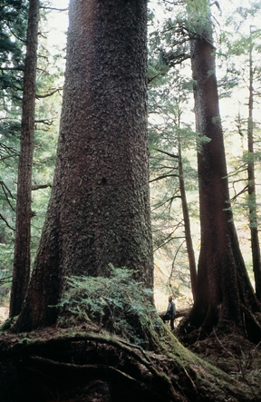

The Alaskan rainforest:
How do you describe it?
Jack Gustafson, ADF&G
Notes:
For information on this program/publication or to find out about additional educational materials provided by the Alaska Department of Fish and Game, please contact ADF&G Wildlife Education & Outreach Coordinator, Kristen Romanoff, the Southeast Wildlife Education Specialist, Abby Lowell at (907) 465-4292 or check out our website at www.wildlife.alaska.gov.
The State of Alaska is an Affirmative Action/Equal Opportunity Employer. Contact the Division of Wildlife Conservation at (907) 465-4190 for alternative formats of this publication.

